Slide 1
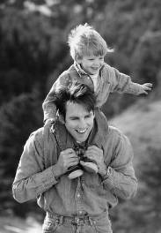
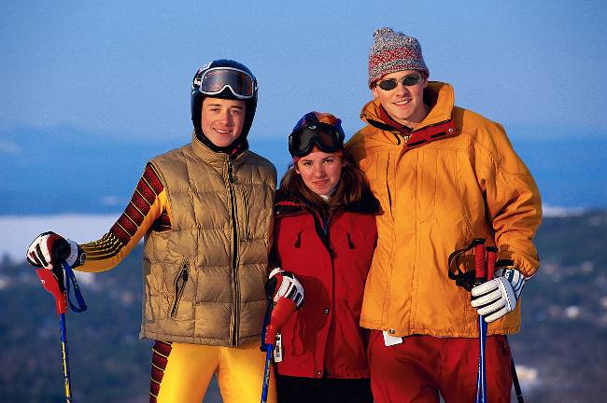

Man and His World
Our Search for Meaning
and Happiness

Slide 2
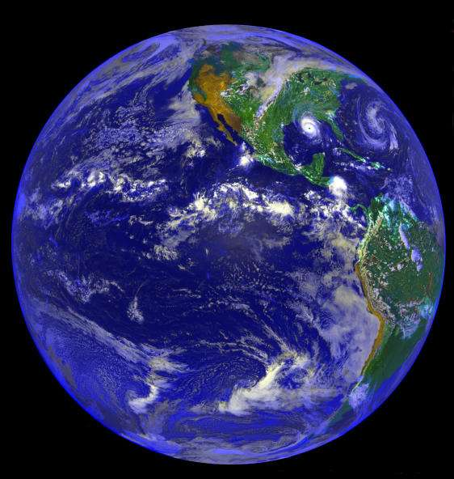
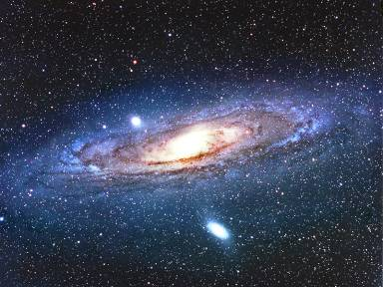
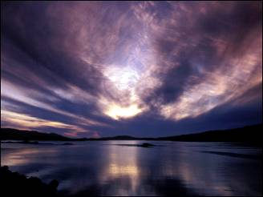
The World Out There
The beauty of creation

Slide 3
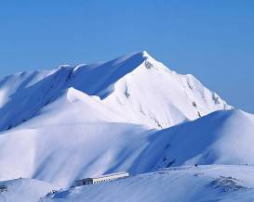
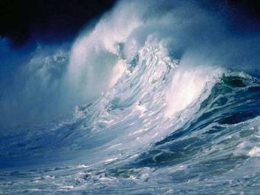
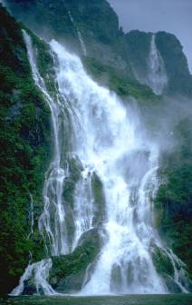


The Beauty of Creation

Slide 4
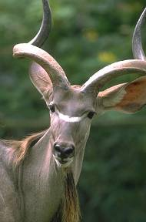

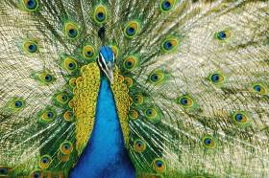
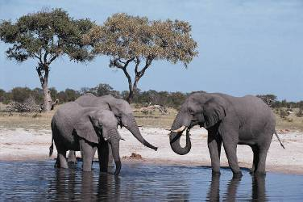

The Beauty of Creation

Slide 5
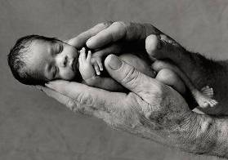


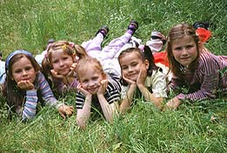
The Beauty of the Human Person

Slide 6
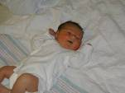



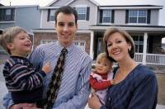
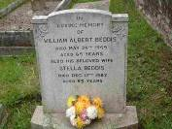
Does Life Have a Meaning?
Birth
Death
The seemingly random course of life and human history.
What is the meaning of life?
Where do we come from? Where are we going?

Slide 7
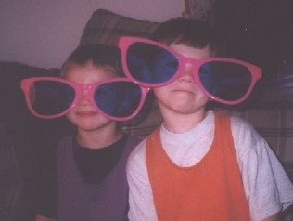
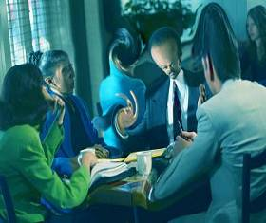

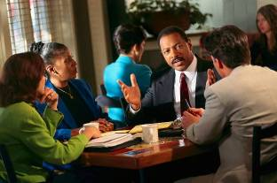
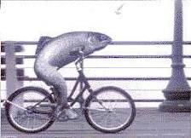
Reality Check: Why Seek Truth?
The importance of seeing reality as it really is.
A false view of reality is insanity; missing out on the very purpose of life.
What determines my view of reality?
  Myself, my own experience?
  My family upbringing?
  Society and its accepted values?
Notes:
Cf. Sheed, Theology and Sanity, A Map of Life

Slide 8
Popular Worldviews
Atheism: God does not exist.
Agnosticism: impossible to know whether God exists.
Naturalism: all phenomena can be explained in terms of natural causes and laws.
Materialism: physical matter is the only reality; everything, including thought, feeling, mind, and will, can be explained in terms of matter and physical phenomena.
Deism: God created the universe and then abandoned it, assuming no control over life, exerting no influence on natural phenomena, and giving no supernatural revelation.
Pantheism: we are all a part of God.
Relativism: truth and moral values are not absolute but relative to the persons or groups holding them.
Theism: God exists, is active in the world and in our lives, and has a good plan for humanity and for each person.
Notes:
Source of definitions: dictionary.com

Slide 9








Man: Strange Animal
What is man?
  A random product of evolution?
  A highly evolved animal?
  A spiritual being, created in the image and likeness of God?

Slide 10






The Human Person
Man has a body and lives in a material world.
A life-principle animates his body: the soul.
The mind has power over matter.
Every living body has a soul (plant, animal, human).
But man’s soul has special faculties: he thinks (abstract thoughts), feels, doubts, loves, creates, is capable of self-consciousness.
Man’s soul is a spirit, with an intellect,
will, and affections.
Notes:
Frank Sheed, Theology for Beginners, chap. 1
Frank Sheed, Catholic Evidence Training Outlines, p. 303f.

Slide 11

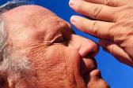
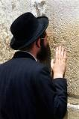
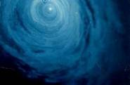
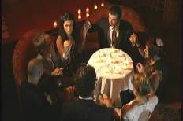
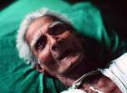
Matter and Spirit
The world is a union of matter and spirit.
Evidence for the world of spirit:
  Love
  The human person’s longing for “more.”
  The voice of man’s conscience.
  Man’s religious inclination (faith or superstition).
  Man’s search for ultimate meaning.
  Miracles and experiences of the supernatural.
  Out-of-body or near-death experiences.
Notes:
Cf. Sheed, Theology for Beginners

Slide 12
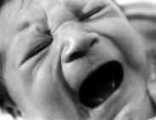
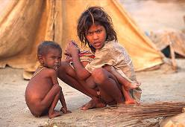
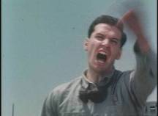
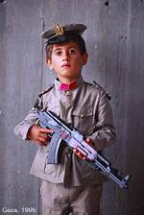
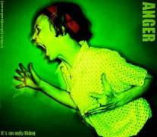
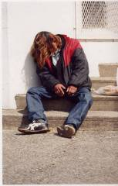
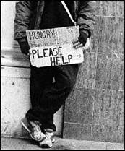
The Problem of Evil
Why is there evil, pain, and suffering in the world?

Slide 13
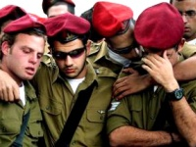
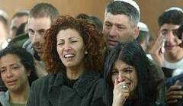
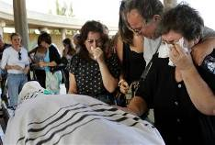
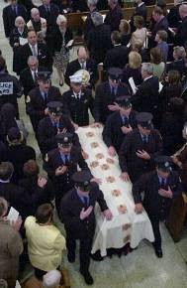
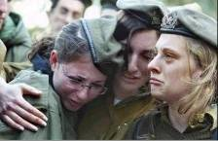
Death: Longing for Immortality
The sense of abnormal loss at death;
Man’s sense of moral goodness and desire for justice: that good be rewarded and evil punished.
Man’s longing for immortality and infinite happiness.
The mystery of the afterlife.

Slide 14


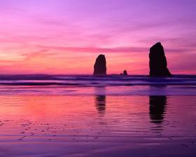

Longing for “More”…
Man’s hunger for truth, goodness, and beauty.
Man’s unquenchable thirst for love.

Slide 15
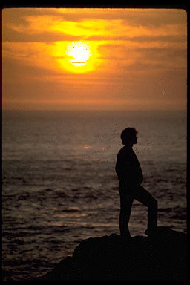
God?
Is there “someone” out there who is in control – who can help us?
An impersonal “higher power” or a personal, loving God?
The problem of relativism: does man invent truth, or is he called to discover it?
The desire for God is written in the human heart, because man is created by God and for God; and God never ceases to draw man to himself. Only in God will he find the truth and happiness he never stops searching for. (CCC 27)

Slide 16
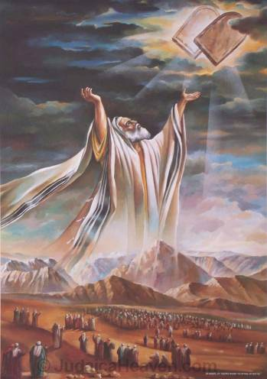
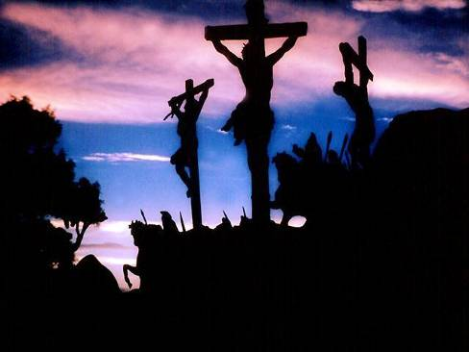
Revelation?
If God exists, does He have something to say to us?
Has God spoken in history?

Slide 17
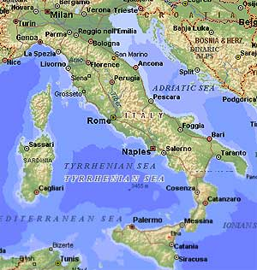
A Map of Life
Divine revelation is a map that God has given us to show us the meaning of life.
We can trust the map because God has given it to us.
The map tells us:
  What we are to believe: Who we are, who God is, why we live…
  How we are to live
We cannot live right if we ignore this map of life.
It is our responsibility to pursue revelation and pass it on.

Slide 18

Prayer/Meditation
I open myself to the truth that will set me free, that will help me to know myself, reach my full potential and discover true love.
I want to see reality as it is. I want to discover the truth; not invent some wishful illusion or fantasy.
Am I willing to let go of any illusions or lies that distort my view of reality?
Am I willing to let go of false beliefs and bad habits, and to make changes in my life if necessary?
God, if there is an infinitely just and good God who loves me and wants the best for me, I would like to know you.

Slide 19
Sources and Recommended Reading
Frank Sheed, A Map of Life, New York: Sheed & Ward, 1939.
__________, Catholic Evidence Training Outlines, Ann Arbor: Catholic Evidence Guild, 1992.
__________, Theology and Sanity, San Francisco: Ignatius Press, 1993.
__________, Theology for Beginners, Ann Arbor: Servant Books, 1981.
© 2016 Catholics for Israel (www.catholicsforisrael.com)

